Slide 1

White Wine Quality
Group Members:
Mengtian Song
Qing Dong
Wenxin Liang
Yuying Chen
Yi Jiang

Slide 2

Background
Nowadays more and more consumers will choose white wine as their favorite luxury good
White wine quality evaluation is the key part to keep the white wine safe for the consumers and to develop the technologies of wine making

Slide 3
Objective
Find out predictors have more influence on determining the quality of white wine
Find out models are more capable for predicting quality of the white wine

Slide 4
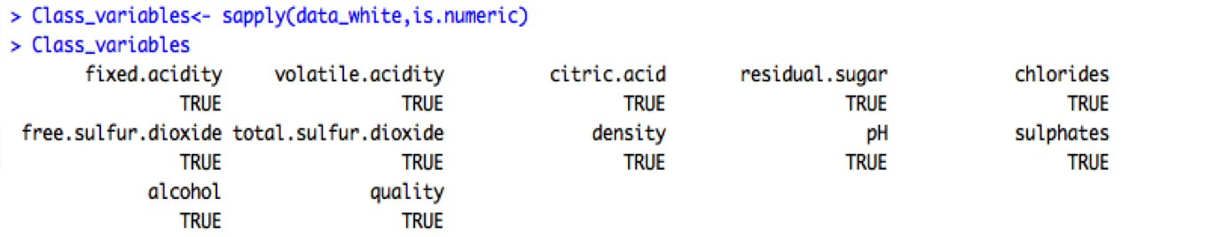
Data Source
Paulo Cortez, UCI Machine Learning Repository, http://archive.ics.uci.edu/ml/datasets/Wine+Quality
The data include 11 physicochemical (inputs) and Quality which score between 0 and 10 (output) variables
All of the variables are numeric
Notes:
We can observe that the inputs, fixed acidity, volatile acidity, citric acid, residual sugar, chlorides, free sulfur dioxide, total sulfur dioxide, density, pH, sulphates, and alcohol are numeric and the output quality is scored between 0 and 10.

Slide 5
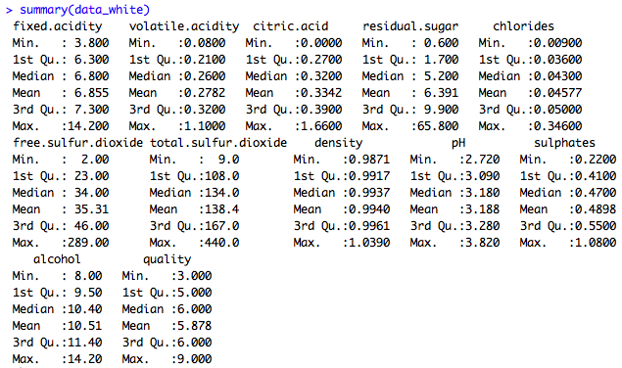
Data Source
Quality scores between 3 and 9
For the predictors, mean is usually greater than the median which showed there are outliers in the data set
Notes:
We can observe that the inputs, fixed acidity, volatile acidity, citric acid, residual sugar, chlorides, free sulfur dioxide, total sulfur dioxide, density, pH, sulphates, and alcohol are numeric and the output quality is scored between 0 and 10.
For the inputs, mean is usually greater than the median. These observations indicate that there are outliers in the data set and before any analysis is performed outliers must be taken care of.

Slide 6
Preparations
Outliers checking by Boxplots
Correlation between predictors

Slide 7
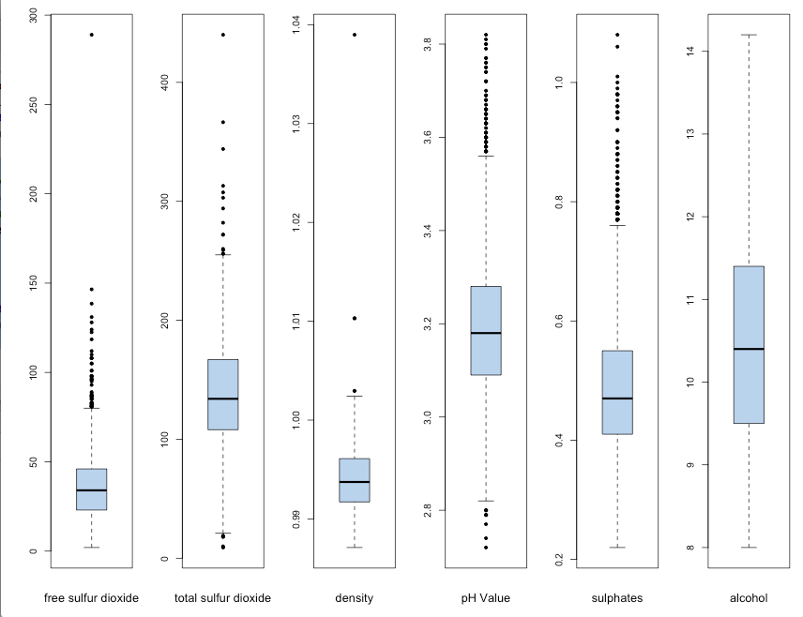
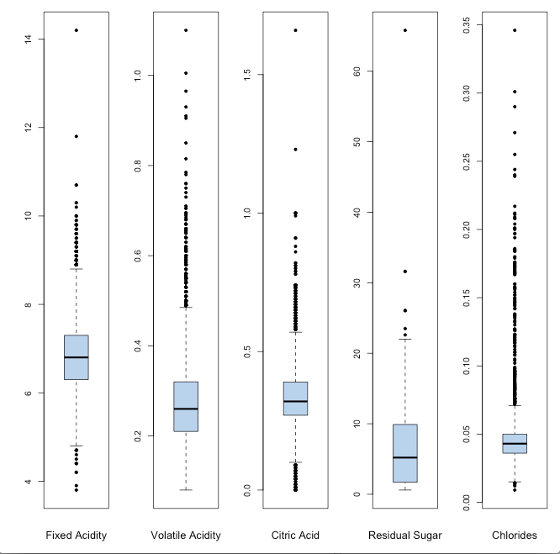
Preparations: Outliers
Boxplots
Fixed acidity, Volatile acidity, Citric acid Free sulfur dioxide and Density have outliers
Residual sugar has a positively skewed distribution

Slide 8
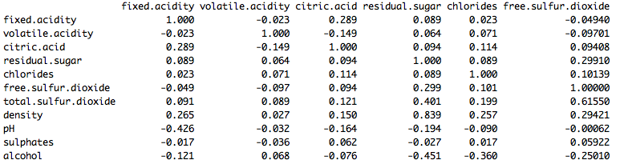
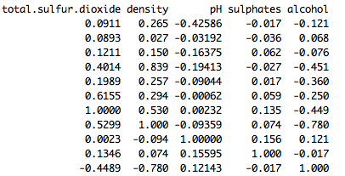
Preparations: Correlation
High correlations (≥ 40% in absolute value) are identified and marked in red
Notes:
Fixed Acidity and pH are correlated.
Residual sugar and total sulfur dioxide are correlated.
Residual sugar and density are correlated.
Residual sugar and alcohol are correlated.
Free sulfur dioxide and total sulfur dioxide are correlated.
Total sulfur dioxide and density are correlated.
Total sulfur dioxide and alcohol are correlated.
Density and alcohol are correlated.

Slide 9
Methodology
Multiple Regression
Ridge
Lasso
Support Vector Machine
Decision Tree
Random Forest (Classification)
Random Forest (Regression)

Slide 10

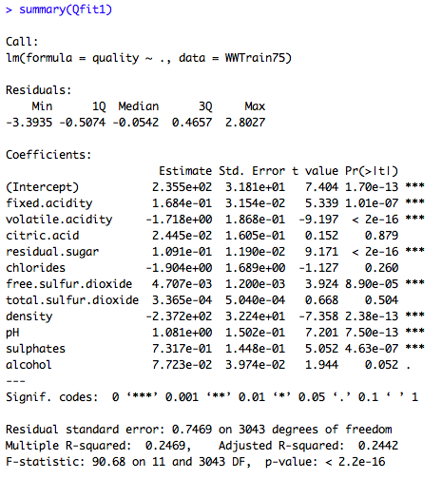
Multiple Regression
Notes:
Here we know that the predictors citric Acid, chlorides and total sulfur dioxide are not significant.
The R square for the predictions is nearly 27% which is not so good.
The error rate for the predictions is nearly 48% which is also not so good.
(Since the quality is scored between 0 and 10 then when find the error rate we need to make the prediction of quality into integers then calculate the error rate)

Slide 11
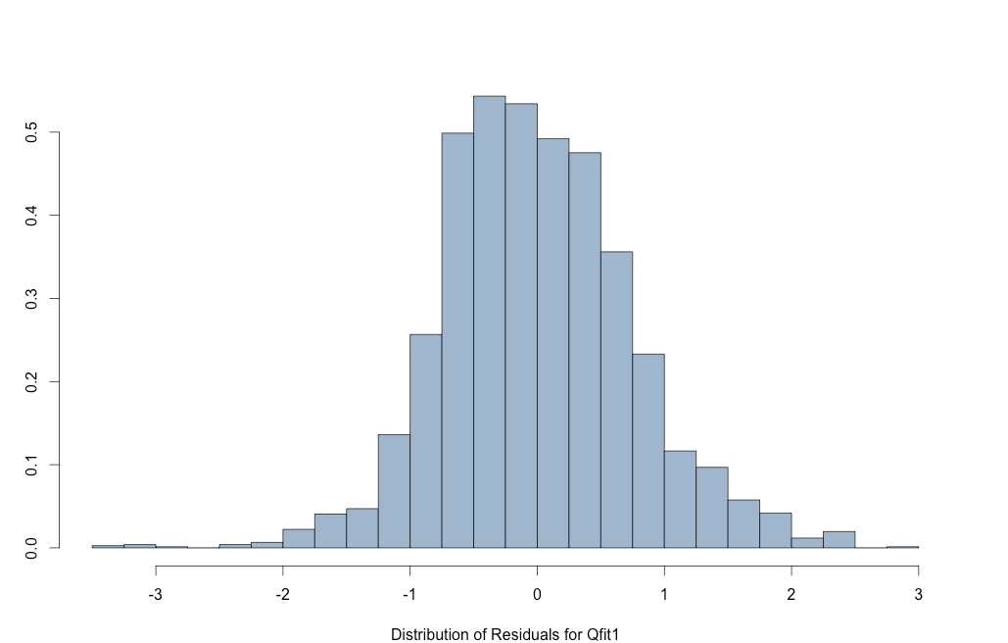
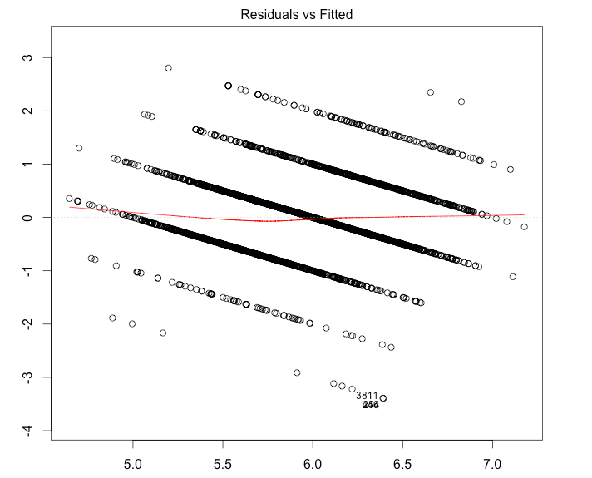
Multiple Regression
Residuals have an approximately Normal Distribution
Since the response actually takes only integer values but has been assumed to be continuous,the linearity is valid

Slide 12
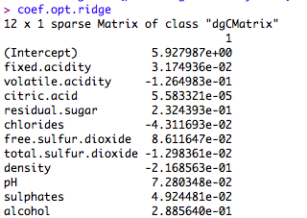


Ridge

Slide 13
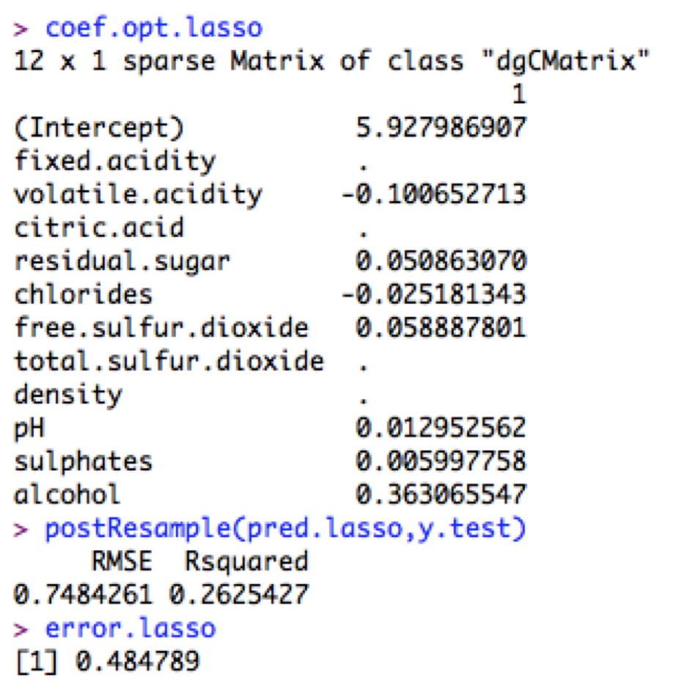
Lasso
Notes:
Then we try lasso regression. In the result of lasso, fixed.acidity, citric.acid, total.sulfur.dioxide, density are dropped. These parameter dropped are the correlated predictors shown in the correlation part we have mentioned.
The R square for the predictions is nearly 26%, and the error rate for the predictions is nearly 48%, which are still not good. We can say that linear regression is not that appropriate for this data set.

Slide 14


Support Vector Machine
SVM is expected to be less sensitive to outliers and this effect results in a higher accuracy for low error tolerances

Slide 15
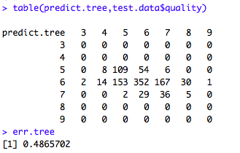
Decision Tree

Slide 16
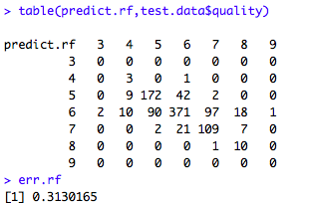
Random Forest (Classification)

Slide 17
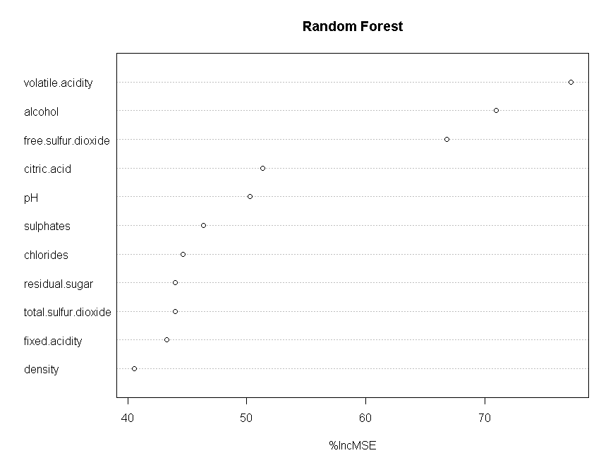
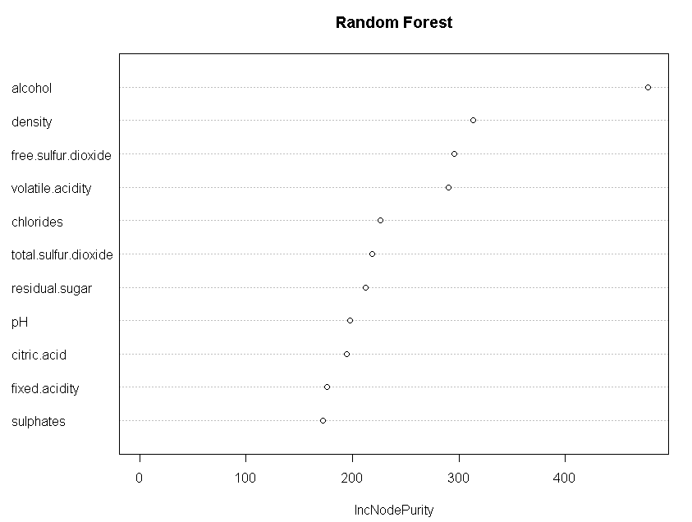
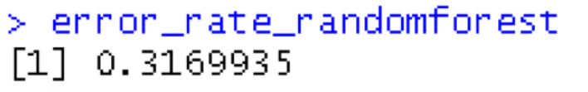
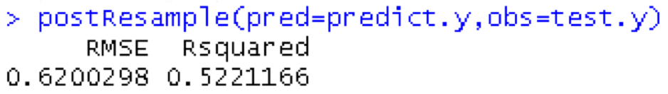
Random Forest (Regression)
Alcohol, Free sulfur dioxide and Volatile acidity have more influence on white wine quality than other predictors
Notes:
Since the Random Forest is one of the most accurate learning algorithms available, we should try this model. Based on decision trees, the algorithm nature makes Random Forest suitable to regression and classification. The advantages include efficiency on large data, Can handle thousands of input variables without variable deletion, Gives estimates of what variables are important in the classification, Generated forests can be saved for future use on other data.
the error rate for random forest with regression prediction is almost 31.7%.

Slide 18
Results
Method | Error Rate | R²
Multiple Regression | 0.4818449 | 0.2737022
Ridge | 0.4789009 | 0.2784749
Lasso | 0.484789 | 0.2625427
Support Vector Machine | 0.4698320 | 0.2956326
Random Forest (Regression) | 0.3169935 | 0.5221166
Decision Tree | 0.4865702
Random Forest (Classification) | 0.3130165

Slide 19
Results
Since the values of R² are very small,regression models cannot appropriately fit the data
Alcohol, Free sulfur dioxide and Volatile acidity have more influence on white wine quality than other predictors.
Since error rate for random forest is lower than other methods,random forest can be a more capable model for predicting quality of the white wine

Slide 20
Future Study
Polynomial Regression
Adaboost
Classified wine into three categories(low, median, high)

Slide 21
Q & A

Slide 22
Thanks for watching

